Slide 1
Becoming a11y
An Intro to Web Accessibility

Slide 2
Let’s chat!
Which device was hardest to use?
Did your application work?
Any thoughts or feelings to share?

Slide 3
a11y?
Accessibility (a11y) is a measure of a computer system's accessibility to all people, including those with disabilities or impairments. It concerns both software and hardware and how they are configured in order to enable a disabled or impaired person to use that computer system successfully.*https://www.techopedia.com/definition/10165/accessibility-a11y
Accessibility is also known as assistive technology.
Accessibility makes an application inclusive to all potential users
Accessibility creates better UX for all users

Slide 4
Why do you think accessibility matters?

Slide 5
Why Does Accessibility Matter
Potential legal risks
WCAG compliance
Reach more customers
The right thing to do

Slide 6

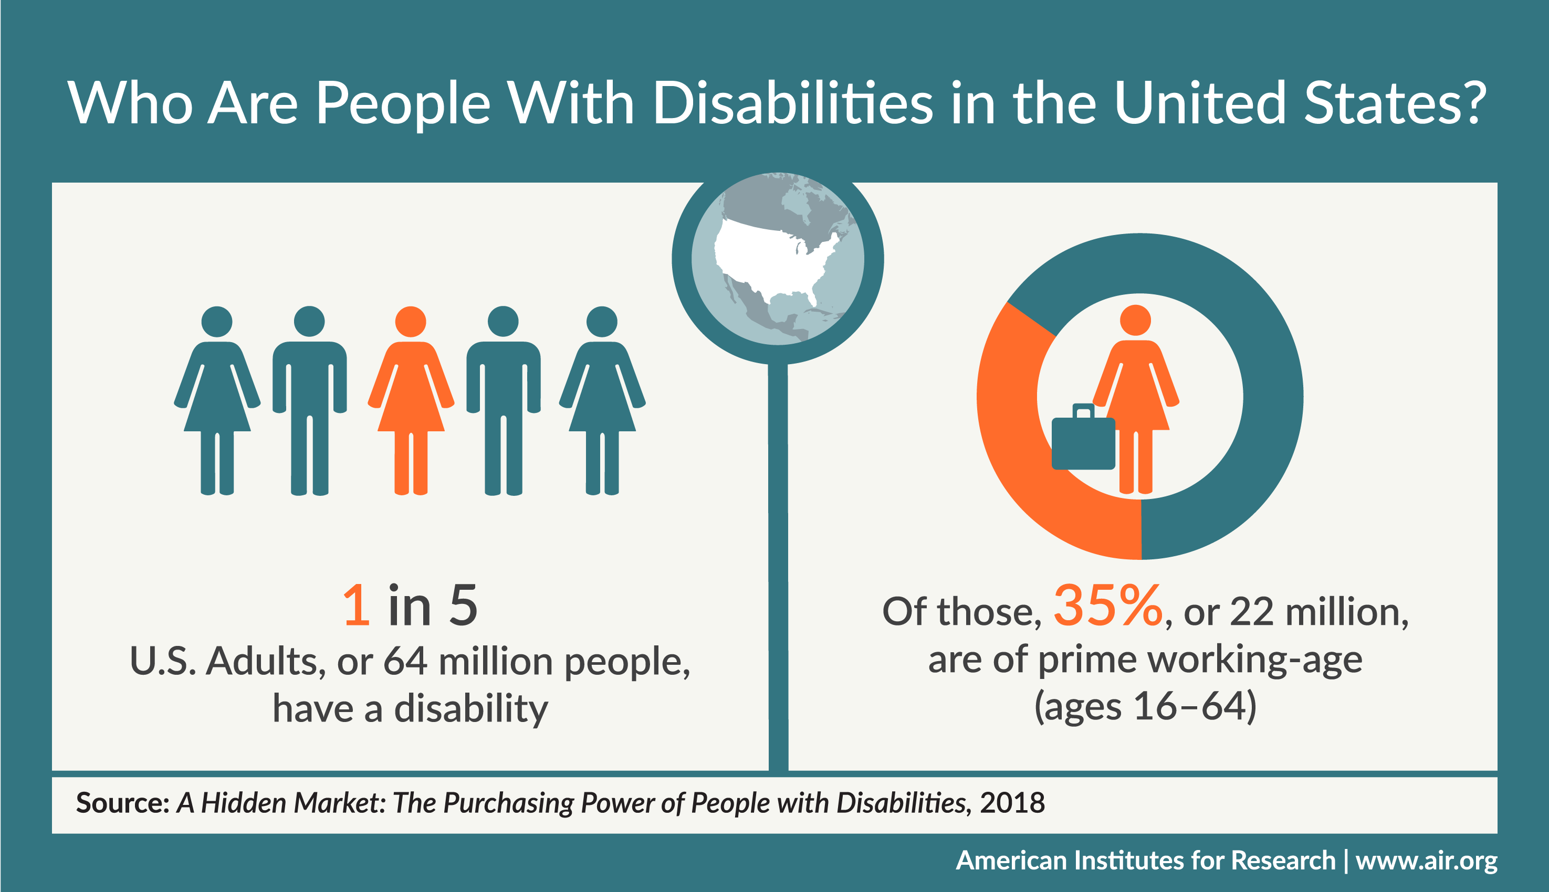
How may users?

Slide 7
What disabilities can cause barriers in using the web?

Slide 8
Diversity of disabled users
Visual and Auditory
Cognitive/ Learning/ Neurological
Physical
Blind
Reduced or low vision
Color blindness
Deaf
Hearing loss
ADHD
Autism Spectrum Disorder (ASD)
Intellectual Disabilities
Learning Disabilities
Mental Health Challenges
Memory Impairments
Multiple Sclerosis (MS)
Seizure Disorders
Amputation
Arthritis
Fibromyalgia
Reduced Dexterity
Muscular Dystrophy
Tremors and Spasms
Paralysis

Slide 9
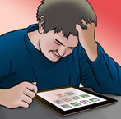
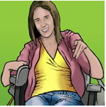

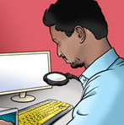
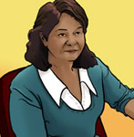
User Personas
Luke
Sarah
Mike
Victor
Maria
High school student
Autism Spectrum Disorder (ASD)
Likes video games
Poor social skills
Difficulty with visual comprehension
College student
Has cerebral palsy
Uses mobility scooter
Uses computer for communication
Paralegal
Blind since birth
Proficient with technology
Uses screen readers
Engineer
Low vision due to glaucoma
Uses screen readers and contrast adjustment
Community health worker
Late adopter. Mobile phone was her first computer
ESL primary language Spanish
Uses computer translations, needs clearly written information
Reference- https://rosenfeldmedia.com/a-web-for-everyone/personas-for-accessible-ux/

Slide 10
What’s in WCAG 2.0?
Principal 1: Perceivable
Information and user interface components must be presentable to users in ways they can perceive.
Principal 2: Operable
User interface components and navigation must be operable.
Principal 3: Understandable
Information and the operation of user interface must be understandable.
Principal 4: Robust
Content must be robust enough that it can be interpreted reliably by a wide variety of user agents, including assistive technologies.

Slide 11
Conformance Levels
Level A: Minimum level of conformance (Must)
Level AA: Enhanced level of conformance (Should)
Level AAA: Best level of conformance (May)

Slide 12
Looking forward WCAG 2.1
Success criteria to conformance levels modified
Additional guidelines added
Perceivable
1.3 Adaptable 3 new guidelines
1.4 Distinguishable 4 new guidelines
Operable
9 additional guidelines
Robust
4.1 Compatible
WCAG “Silver” under development

Slide 13
Keeping up with the trends
Law Office of Lainey Feingold
Leading law firm in accessibility
https://www.lflegal.com/
WebAIM
Leaders in accessibility
Site has reference docs and training
https://webaim.org/

Slide 14
Accessibility Baked In

Slide 15
Accessibility vs Inclusive Design PS: Inclusive design wins
Accessibility
Inclusive Design
Typically an after thought
Fixing symptoms not root cause
Accessibility is central to design
Improves experience for all users
Less compliance fixes needed

Slide 16
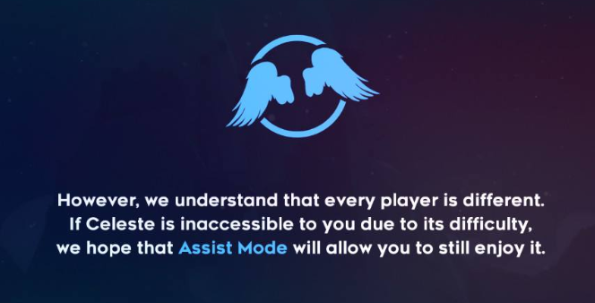
Accessibility should be central to your application development
Celeste
Reduce difficulty
Reduce speed
Infinite lives
Remove screen shake
Remove strobe
Change button configuration

Slide 17


Slide 18
Key Takeaways
WCAG Guidelines
Accessibility baked in from inception
Diversity of disabled community
User personas guide our testing and development
Accessibility improves an application for all users, not just disabled users

Slide 19
Resources
Web Accessibility Initiative- https://www.w3.org/WAI/
User Personas- https://rosenfeldmedia.com/a-web-for-everyone/personas-for-accessible-ux/
Web Accessibility Automation Tool- https://www.axe-core.org/
Switch Demo- https://www.youtube.com/watch?v=5btytT9SPA4
Snooks color contrast-https://snook.ca/technical/colour_contrast/colour.html#fg=FFFFFF,bg=D51D7E Switch definition- www.c3schools.org/MHEC/WebCT/Adaptive_Switches.doc
a11y- https://www.techopedia.com/definition/10165/accessibility-a11y
Number of disabled users- https://www.air.org/news/press-release/meeting-needs-adults-disabilities-marketplace

